Slide 1
Linux Booting Procedure

Slide 2
Linux Booting Procedure

Slide 3
By the end of the course you will:
Be able to familiar with common Linux boot problems and gets hands on experience on basic system recovery with various lab sessions.
Be able to confidently use the Linux operating system to increase your productivity and Career.
Be able to perform everyday computing tasks from the Linux command line.

Slide 4
LINUX Basic Course Outline
Troubleshooting Linux Boot Problems in Red Hat Linux (Basic System Recovery)
Linux Boot process
Booting of RHEL 7 with systemd
Lab on Basic System Recovery (Initramfs file missing/Corrupted)
Lab on Basic System Recovery (Grub related issues like stage 1.5/2 grub is missing)-Part1

Slide 5
LINUX Basic Course Outline
Troubleshooting Linux Boot Problems in Red Hat Linux (Basic System Recovery)
Lab on Basic System Recovery (Grub related issues like stage 1.5/2 grub is missing)-Part2
Lab on Basic System Recovery (Master Boot Record missing/corrupted)
Lab on Basic System Recovery (Critical files are missing like mount binary)
Lab on Basic System Recovery (/boot fs is completely wiped out or corrupted)

Slide 6
LINUX Basic Course Outline
Red Hat Enterprise Linux 7
Overview about RHEL7 with its new features
Comparison with RHEL 6
Lab on systemd service (Familiar with different systemd targets & new commands)
Practice Lab Session on systemctl status/stop/start/enable/disable <service>
Practice Lab Session on default target, list dependencies & journalctl etc

Slide 7
LINUX Basic Course Outline
Booting modes in RHEL 7
Rescue mode in RHEL 7
Lab on rescue mode
Emergency mode in RHEL 7
Lab on emergency mode
Troubleshooting mode (Overview and Lab)
Lab on Recovering the Root password in RHEL7
  Resetting the Root Password Using an Installation Disk
  Resetting the Root Password Using rd.break

Slide 8
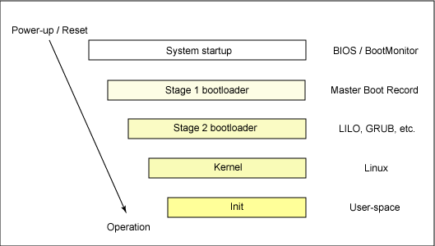
How Linux boot?

Slide 9
How computer startup?
Booting is a bootstrapping process that starts operating systems when the user turns on a computer system
A boot sequence is the set of operations the computer performs when it is switched on that load an operating system

Slide 10
Booting sequence
Turn on
CPU jump to address of BIOS (0xFFFF0)
BIOS runs POST (Power-On Self Test)
Find bootale devices
Loads and execute boot sector form MBR
Load OS

Slide 11
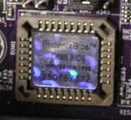
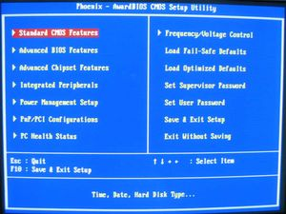
BIOS (Basic Input/Output System)
BIOS refers to the software code run by a computer when first powered on
The primary function of BIOS is code program embedded on a chip that recognises and controls various devices that make up the computer.
BIOS on board
BIOS on screen

Slide 12
MBR (Master Boot Record)
OS is booted from a hard disk, where the Master Boot Record (MBR) contains the primary boot loader
The MBR is a 512-byte sector, located in the first sector on the disk (sector 1 of cylinder 0, head 0)
After the MBR is loaded into RAM, the BIOS yields control to it.

Slide 13
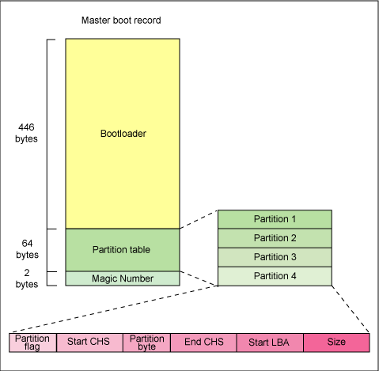
MBR (Master Boot Record)

Slide 14
MBR (Master Boot Record)
The first 446 bytes are the primary boot loader, which contains both executable code and error message text
The next sixty-four bytes are the partition table, which contains a record for each of four partitions
The MBR ends with two bytes that are defined as the magic number (0xAA55). The magic number serves as a validation check of the MBR

Slide 15
Extracting the MBR
To see the contents of MBR, use this command:
# dd if=/dev/hda of=mbr.bin bs=512 count=1
# od -xa mbr.bin
**The dd command, which needs to be run from root, reads the first 512 bytes from /dev/hda (the first Integrated Drive Electronics, or IDE drive) and writes them to the mbr.bin file.
**The od command prints the binary file in hex and ASCII formats.

Slide 16
Boot loader
Boot loader could be more aptly called the kernel loader. The task at this stage is to load the Linux kernel
Optional, initial RAM disk
GRUB and LILO are the most popular Linux boot loader.

Slide 17
Other boot loader (Several OS)
bootman
GRUB
LILO
NTLDR
XOSL
BootX
loadlin
Gujin
Boot Camp
Syslinux
GAG

Slide 18
GRUB: GRand Unified Bootloader
GRUB is an operating system independant boot loader
A multiboot software packet from GNU
Flexible command line interface
File system access
Support multiple executable format
Support diskless system
Download OS from network
Etc.

Slide 19
GRUB boot process
The BIOS finds a bootable device (hard disk) and transfers control to the master boot record
The MBR contains GRUB stage 1. Given the small size of the MBR, Stage 1 just load the next stage of GRUB
GRUB Stage 1.5 is located in the first 30 kilobytes of hard disk immediately following the MBR. Stage 1.5 loads Stage 2.
GRUB Stage 2 receives control, and displays to the user the GRUB boot menu (where the user can manually specify the boot parameters).
GRUB loads the user-selected (or default) kernel into memory and passes control on to the kernel.

Slide 20
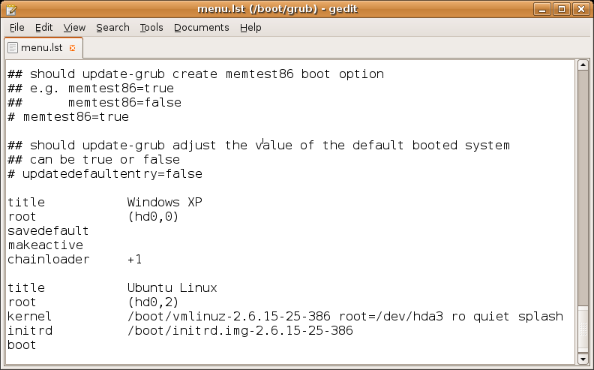
Example GRUB config file

Slide 21
Kernel image
The kernel is the central part in most computer operating systems because of its task, which is the management of the system's resources and the communication between hardware and software components
Kernel is always store on memory until computer is tern off
Kernel image is not an executable kernel, but a compress kernel image
zImage size less than 512 KB
bzImage size greater than 512 KB

Slide 22
Init process
The first thing the kernel does is to execute /sbin/init program
Init is the root/parent of all processes executing on Linux
The first processes that init starts is a script /etc/rc.d/rc.sysinit
Based on the appropriate run-level, scripts are executed to start various processes to run the system and make it functional

Slide 23
Init process
The /sbin/init program (also called init) coordinates the rest of the boot process and configures the environment for the user.
When the init command starts, it becomes the parent or grandparent of all of the processes that start up automatically on the system. First, it runs the /etc/rc.d/rc.sysinit script, which sets the environment path, starts swap, checks the file systems, and executes all other steps required for system initialization. For example, most systems use a clock, so rc.sysinit reads the /etc/sysconfig/clock configuration file to initialize the hardware clock. Another example is if there are special serial port processes which must be initialized, rc.sysinit executes the /etc/rc.serial file.
The init command then runs the /etc/inittab script, which describes how the system should be set up in each SysV init runlevel. Runlevels are a state, or mode, defined by the services listed in the SysV /etc/rc.d/rc<x>.d/ directory

Slide 24
The Linux Init Processes
The init process is identified by process id "1“
Init is responsible for starting system processes as defined in the /etc/inittab file
Init typically will start multiple instances of "getty" which waits for console logins which spawn one's user shell process
Upon shutdown, init controls the sequence and processes for shutdown

Slide 25
System processes
Process ID | Description
0 | The Scheduler
1 | The init process
2 | kflushd
3 | kupdate
4 | kpiod
5 | kswapd
6 | mdrecoveryd

Slide 26
Inittab file
The inittab file describes which processes are started at bootup and during normal operation
  /etc/init.d/boot
  /etc/init.d/rc
The computer will be booted to the runlevel as defined by the initdefault directive in the /etc/inittab file
  id:5:initdefault:

Slide 27
Runlevels
A runlevel is a software configuration of the system which allows only a selected group of processes to exist
The processes spawned by init for each of these runlevels are defined in the /etc/inittab file
Init can be in one of eight runlevels: 0-6

Slide 28
How Linux boot?

Slide 29
Runlevels
Runlevel | Scripts Directory (Red Hat/Fedora Core) | State
0 | /etc/rc.d/rc0.d/ | shutdown/halt system
1 | /etc/rc.d/rc1.d/ | Single user mode
2 | /etc/rc.d/rc2.d/ | Multiuser with no network services exported
3 | /etc/rc.d/rc3.d/ | Default text/console only start. Full multiuser
4 | /etc/rc.d/rc4.d/ | Reserved for local use. Also X-windows (Slackware/BSD)
5 | /etc/rc.d/rc5.d/ | XDM X-windows GUI mode (Redhat/System V)
6 | /etc/rc.d/rc6.d/ | Reboot
s or S |  | Single user/Maintenance mode (Slackware)
M |  | Multiuser mode (Slackware)

Slide 30
rc#.d files
rc#.d files are the scripts for a given run level that run during boot and shutdown
The scripts are found in the directory /etc/rc.d/rc#.d/ where the symbol # represents the run level

Slide 31
init.d
Deamon is a background process
init.d is a directory that admin can start/stop individual demons by changing on it
  /etc/rc.d/init.d/ (Red Hat/Fedora )
  /etc/init.d/ (S.u.s.e.)
  /etc/init.d/ (Debian)

Slide 32
Start/stop deamon
Admin can issuing the command and either the start, stop, status, restart or reload option
i.e. to stop the web server:
  cd /etc/rc.d/init.d/
  (or /etc/init.d/ for S.u.s.e. and Debian)
  httpd stop

Slide 33
Overview of RHEL 7
Features
Logging
Dependencies
Cgroups
Activating Services
Familiar with systemd Commands
Graphical.target
Multi-user.target
Basic.target
Sysinit.target
Local-fs.target

Slide 34
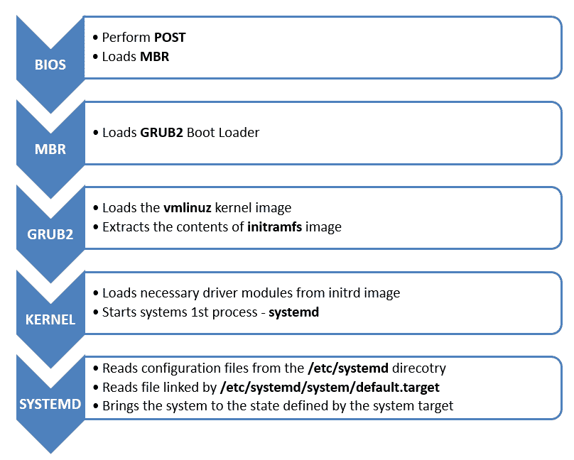
Red Hat Enterprise Linux 7 Booting Process

Slide 35
BIOS
BIOS stands for Basic Input/output System
Performs some system integrity checks
Searches, loads, and executes the boot loader program.
It looks for boot loader in floppy, CD-ROMs, or hard drive. You can press a key (typically F12 of F2, but it depends on your system) during the BIOS startup to change the boot sequence.
Once the boot loader program is detected and loaded into the memory, BIOS gives the control to it.
So, in simple terms BIOS loads and executes the MBR boot loader.

Slide 36
MBR
MBR stands for Master Boot Record.
It is located in the 1st sector of the bootable disk. Typically /dev/hda, or /dev/sda
MBR is less than 512 bytes in size. This has three components as shown:
  Primary boot loader info in 1st 446 bytes
  Partition table info in next 64 bytes
  MBR validation check in last 2 bytes.
It contains information about GRUB2 (GRUB or LILO in old systems).
So, in simple terms MBR loads and executes the GRUB2 boot loader.

Slide 37
MBR (Master Boot Record)

Slide 38
GRUB: GRand Unified Bootloader
GRUB
GRUB stands for GRand Unified Bootloader. Its function is to take over from BIOS at boot time, load itself, load the Linux kernel into memory, and then turn over execution to the kernel. Once the kernel takes over, GRUB has done its job and it is no longer needed.
GRUB supports multiple Linux kernels and allows the user to select between them at boot time using a menu.

Slide 39
GRUB: GRand Unified Bootloader
GRUB Menu
The function of the GRUB menu is to allow the user to select one of the installed kernels to boot in the case where the default kernel is not the desired one. Using the up and down arrow keys allows you to select the desired kernel and pressing the Enter key continues the boot process using the selected kernel.
The GRUB menu also provides a timeout so that, if the user does not make any other selection.
The GRUB menu also provides a "rescue" kernel, in for use when troubleshooting or when the regular kernels don't complete the boot process for some reason.

Slide 40
GRUB: GRand Unified Bootloader
The grub.cfg file
The grub.cfg file is the GRUB configuration file. It is generated by the grub2-mkconfig program using a set of primary configuration files and the grub default file as a source for user configuration specifications. The /boot/grub2/grub.cfg file is first generated during Linux installation and regenerated when a new kernel is installed.
The grub.cfg file contains Bash-like code and a list of installed kernels in an array ordered by sequence of installation.

Slide 41
GRUB: GRand Unified Bootloader
GRUB configuration files
The main set of configuration files for grub.cfg is located in the /etc/grub.d directory. Each of the files in that directory contains GRUB code that is collected into the final grub.cfg file.
The delimiting comments look like this:
### BEGIN /etc/grub.d/10_linux ###
### END /etc/grub.d/10_linux ###
These files should not be modified unless you are a GRUB expert and understand what the changes will do. Even then you should always keep a backup copy of the original, working grub.cfg file.

Slide 42
GRUB: GRand Unified Bootloader
GRUB is an operating system independent boot loader
A multiboot software packet from GNU
Flexible command line interface
File system access
Support multiple executable format
Support diskless system

Slide 43
GRUB2
The default bootloader program used on RHEL 7 is GRUB 2. GRUB stands for Grand Unified Bootloader. GRUB 2 replaces the older GRUB bootloader also called as legacy GRUB.
The GRUB 2 configuration file is located at /boot/grub2/grub.cfg (Do not edit this file directly).
GRUB 2 menu-configuration settings are taken from /etc/default/grub when generating grub.cfg.

Slide 44
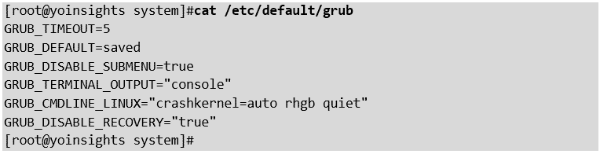
GRUB2
If changes are made to any of these parameters, you need to run grub2-mkconfig to re-generate the /boot/grub2/grub.cfg

Slide 45
GRUB2
Grub has two configuration files namely menu.lst and grub.conf whereas, Grub2 has only one main configuration file namely grub.cfg and it looks very close to a full scripting language.
GRUB2 searches the compressed kernel image file also called as vmlinuz in the /boot
GRUB2 loads the vmlinuz kernel image file into memory and extracts the contents of the initramfs image file into a temporary, memory-based file system (tmpfs).
The initial RAM disk (Initrd) is an initial root file system that is mounted before the real root file system.

Slide 46
GRUB2
In Grub, it is really hard for the normal user to modify the configuration. But Grub2 is more user-friendly, Grub-mkconfig will automatically changes the configuration.
In Grub. partition number starts from 0, whereas in Grub2 it starts with 1
Grub uses physical and logical addresses to address the disk, it can't even read from new paritions whereas, Grub2 uses UUID to identify a disk thus is more reliable. It supports LVM and RAID devices.

Slide 47
GRUB2
Lab Session

Slide 48
About Initramfs – /etc/dracut.conf
The job of the initial RAM file system is to preload the block device modules, such as for IDE, SCSI, or RAID, so that the root file system, on which those modules normally reside, can then be accessed and mounted.
The initramfs is bound to the kernel and the kernel mounts this initramfs as part of a two-stage boot process.
The Dracut utility creates initramfs whenever a new kernel is installed.
Use the lsinitrd command to view the contents of the image created by dracut:
#lsinitrd | less
So, in simple terms GRUB2 just loads and executes Kernel and initramfs images.

Slide 49
Kernel
Linux Kernel is the central core of the OS and it is the first program loaded on the system starts up. While system starting kernel loads all the necessary Kernel Modules and Drives from initrd.img to load system first process systemd in Linux 7.
The kernel starts the systemd process with a process ID of 1 (PID 1) as shown below:
systemd

Slide 50
systemd
Systemd process is the first process ID (PID 1) to run on Linux 7 systems, it initializes the system and launches all the services that were once started by the traditional init (/etc/init.d) process. Systemd process reads the configuration file of /etc/systemd/system/default.target, then its load the OS in targeted target.
This tells systemd to start everything in the /usr/lib/systemd/system/basic.target before starting the other multi-user services.

Slide 51
Troubleshooting of Booting related issues
Scenario 1:
initramfs file missing

Slide 52
Troubleshooting of Booting related issues
Scenario 2:
Grub conf file missing

Slide 53
Troubleshooting of Booting related issues
Scenario 3:
MBR corrupted

Slide 54
Troubleshooting of Booting related issues
Scenario 4:
Critical Files Missing from your system, for example /bin/mount missing

Slide 55
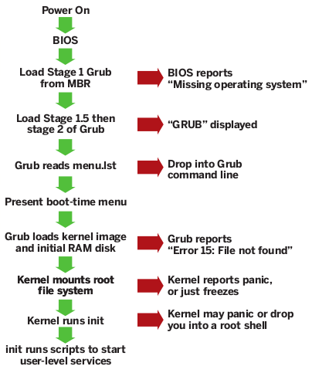
Troubleshooting of Booting related issues

Slide 56
Booting RHEL 7 into Rescue Mode
Rescue mode is equivalent to single user mode and requires the root password
Rescue mode allows you to repair your system in situations when it is unable to complete a regular booting process.
Rescue mode will try to mount all local file systems and start some important system services, but it does not activate network interfaces neither allow multiple users to be logged in.

Slide 57

Booting RHEL 7 into Rescue Mode
There are 2 ways to get into rescue mode :
1. Method 1
There is a GRUB2 menu option when you boot up the system which can be selected to directly boot into rescue mode.

Slide 58
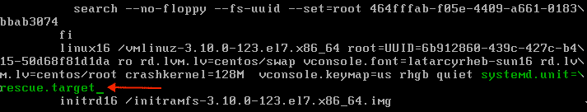
Booting RHEL 7 into Rescue Mode
2. Method 2
1. During bootup, when the GRUB2 menu shows up, press the e key for edit.
2. Add the following parameter at the end of the linux16 line:
Systemd.unit=rescue.target
Press Ctrl+a (or Home) and Ctrl+e (or End) to jump to the start and end of the line.

Slide 59

Booting RHEL 7 into Rescue Mode
3. Press Ctrl+x to boot the system with the parameter.

Slide 60
Booting RHEL 7 into Emergency Mode
Emergency mode provides the most minimal environment possible and allows you to repair your system even in situations when the system is unable to enter rescue mode.
In emergency mode, the system mounts the root file system as read-only, does not attempt to mount any other local file systems, does not activate network interfaces. and only starts few essential services.
In Red Hat Enterprise Linux 7, emergency mode requires the root password.

Slide 61
Booting RHEL 7 into Emergency Mode
Bootup into Emergency mode(target)
1. During bootup, when the GRUB2 menu shows up, press the e key for edit.
2. Add the following parameter at the end of the linux16 line
systemd.unit=emergency.target

Slide 62
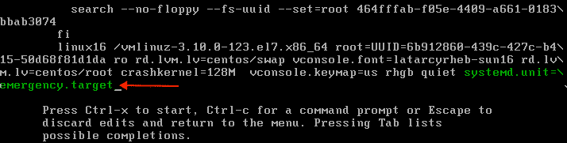

Booting RHEL 7 into Emergency Mode
Press Ctrl+a (or Home) and Ctrl+e (or End) to jump to the start and end of the line.
Press Ctrl+x to boot the system with the parameter.

Slide 63
Switch to Emergency mode(target)
To switch to Emergency target, simply run following command as root:
#systemctl emergency
To prevent systemd from sending informative messages
#systemctl --no-wall emergency
#systemctl isolate emergency.target
Switch to Rescue mode(target)
To switch to rescue target, simply run following command as root:
#systemctl rescue
To prevent systemd from sending informative messages
#systemctl --no-wall emergency
#systemctl isolate emergency.target

Slide 64
Changing and Resetting the Root Password
Setting up the root password is a mandatory part of the Red Hat Enterprise Linux 7 installation. If you forget or lose the root password it is possible to reset it, however users who are members of the wheel group can change the root password as follows:
$ sudo passwd root
The root password is now required to operate in single-user mode as well as in emergency mode.
Two procedures for resetting the root password are shown here:
Resetting the Root Password Using an Installation Disk takes you to a shell prompt, without having to edit the GRUB menu. It is the shorter of the two procedures and it is also the recommended method. You can use a boot disk or a normal Red Hat Enterprise Linux 7 installation disk.

Slide 65
Changing and Resetting the Root Password
Resetting the Root Password Using an Installation Disk
Start the system and when BIOS information is displayed, select the option for a boot menu and select to boot from the installation disk.
Choose Troubleshooting.
Choose Rescue a Red Hat Enterprise Linux System.
Choose Continue which is the default option. At this point you will be promoted for a passphrase if an encrypted file system is found.
Press OK to acknowledge the information displayed until the shell prompt appears.
Change the file system root as follows:
#chroot /mnt/sysimage

Slide 66
Changing and Resetting the Root Password
Enter the passwd command and follow the instructions displayed on the command line to change the root password.
Remove the autorelable file to prevent a time consuming SELinux relabel of the disk:
# rm –f /.autorelabel
Enter the exit command to exit the chroot environment.
Enter the exit command again to resume the initialization and finish the system boot.

Slide 67
Changing and Resetting the Root Password
Procedure 25.5. Resetting the Root Password Using rd.break
Start the system and, on the GRUB 2 boot screen, press the e key for edit.
Remove the rhgb and quiet parameters from the end, or near the end, of the linux16 line, or linuxefi on UEFI systems.
Press Ctrl+a and Ctrl+e to jump to the start and end of the line, respectively. On some systems, Home and End might also work.
IMPORTANT
The rhgb and quiet parameters must be removed in order to enable system messages.
Add the following parameters at the end of the linux line on 64-Bit IBM Power Series, the linux16 line on x86-64 BIOS-based systems, or the linuxefi line on UEFI systems:
rd.break enforcing=0

Slide 68
Changing and Resetting the Root Password
Adding the enforcing=0 option enables omitting the time consuming SELinux relabeling process.
The initramfs will stop before passing control to the Linux kernel, enabling you to work with the root file system.
Note that the initramfs prompt will appear on the last console specified on the Linux line.
Press Ctrl+x to boot the system with the changed parameters.
With an encrypted file system, a password is required at this point. However the password prompt might not appear as it is obscured by logging messages. You can press the Backspace key to see the prompt. Release the key and enter the password for the encrypted file system, while ignoring the logging messages.
The initramfs switch_root prompt appears.
The file system is mounted read-only on /sysroot/. You will not be allowed to change the password if the file system is not writable.

Slide 69
Changing and Resetting the Root Password
Remount the file system as writable:
#mount –o remount,rw /sysroot
The file system is remounted with write enabled.
Change the file system's root as follows:
#chroot /sysroot
The prompt changes to sh-4.2#.
Enter the passwd command and follow the instructions displayed on the command line to change the root password.
Note that if the system is not writable, the passwd tool fails with the following error:
#Authentication token manipulation error

Slide 70
Changing and Resetting the Root Password
Updating the password file results in a file with the incorrect SELinux security context. To relabel all files on next system boot, enter the following command:
# touch /.autorelabel
Alternatively, to save the time it takes to relabel a large disk, you can omit this step provided you included the enforcing=0 option in step 3.
Remount the file system as read only:
# mount –o remount,ro /
Enter the exit command to exit the chroot environment.

Slide 71
Changing and Resetting the Root Password
Enter the exit command again to resume the initialization and finish the system boot.
With an encrypted file system, a pass word or phrase is required at this point. However the password prompt might not appear as it is obscured by logging messages. You can press and hold the Backspace key to see the prompt. Release the key and enter the password for the encrypted file system, while ignoring the logging messages.
NOTE
Note that the SELinux relabeling process can take a long time. A system reboot will occur automatically when the process is complete.
If you added the enforcing=0 option in step 3 and omitted the touch /.autorelabelcommand in step 8, enter the following command to restore the /etc/shadow file's SELinux security context:~]# restorecon
# restorecon /etc/shadow
Enter the following commands to turn SELinux policy enforcement back on and verify that it is on:
Setenforce 1
getenforce

Slide 72
Overview of RHEL 7
Features
Logging
Dependencies
Cgroups
Activating Services
Familiar with systemd Commands
Graphical.target
Multi-user.target
Basic.target
Sysinit.target
Local-fs.target

Slide 73
INTRODUCTION TO GRUB 2
Red Hat Enterprise Linux 7 is distributed with version 2 of the GNU GRand Unified Bootloader (GRUB 2), which allows the user to select an operating system or kernel to be loaded at system boot time. GRUB 2 also allows the user to pass arguments to the kernel.
GRUB 2 reads its configuration from the /boot/grub2/grub.cfg file on traditional BIOS-based machines and from the /boot/efi/EFI/redhat/grub.cfg file on UEFI machines. This file contains menu information.
The GRUB 2 configuration file, grub.cfg, is generated during installation, or by invoking the /usr/sbin/grub2-mkconfig utility, and is automatically updated by grubby each time a new kernel is installed.

Slide 74
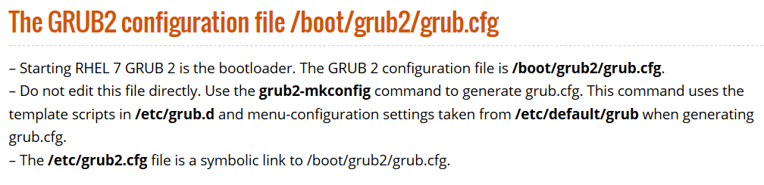
INTRODUCTION TO GRUB 2

Slide 75
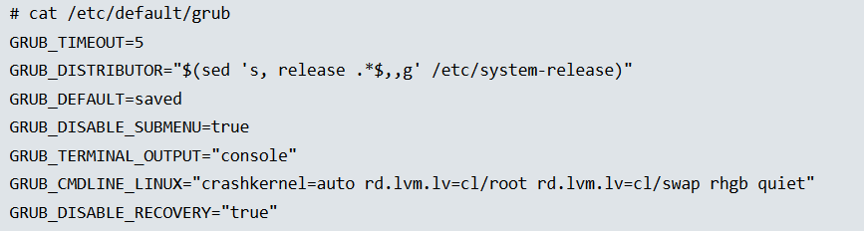
INTRODUCTION TO GRUB 2
The /etc/default/grub file
GRUB2 menu-configuration settings are taken from /etc/default/grub when generating grub.cfg. The contents of grub file

Slide 76
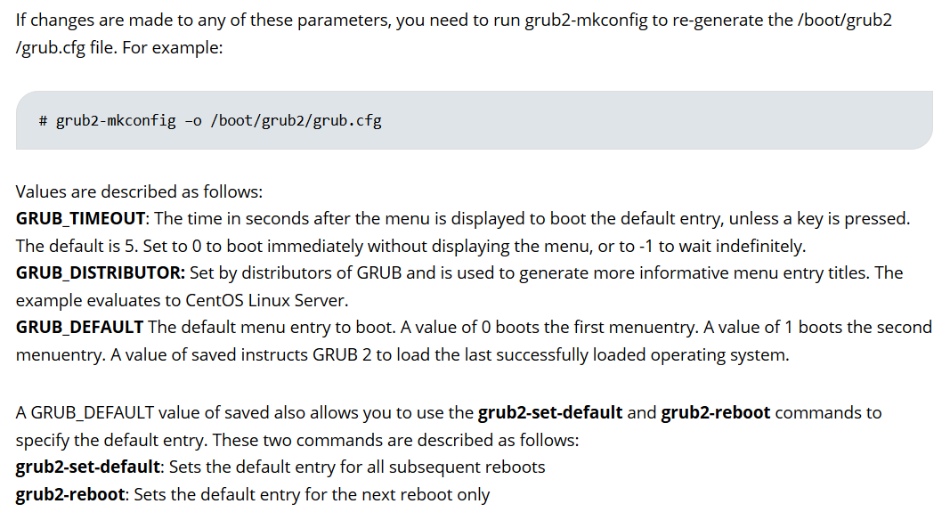
INTRODUCTION TO GRUB 2

Slide 77
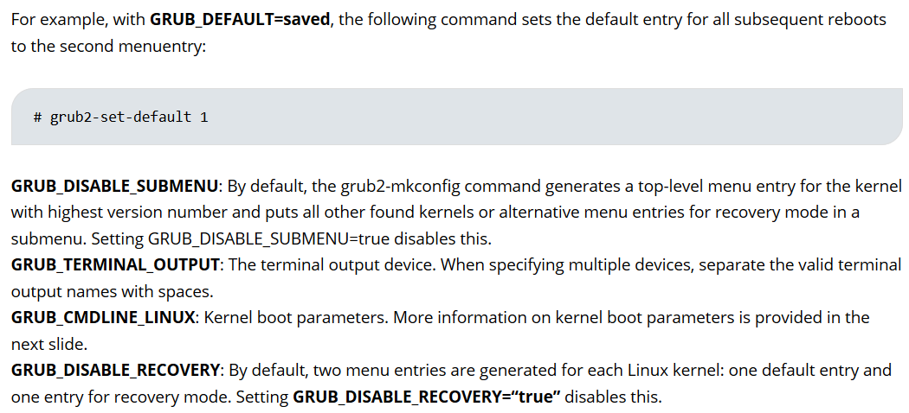
INTRODUCTION TO GRUB 2

Slide 78
INTRODUCTION TO GRUB 2
The /etc/default/grub file
If the changes are made to any of these parameters, you need to run grub2-mkconfig to re-generate the /boot/grub2/grub.cfg file. Fox example
# grub2-mkconfig –o /boot/grub2/grub.cfg

Slide 79
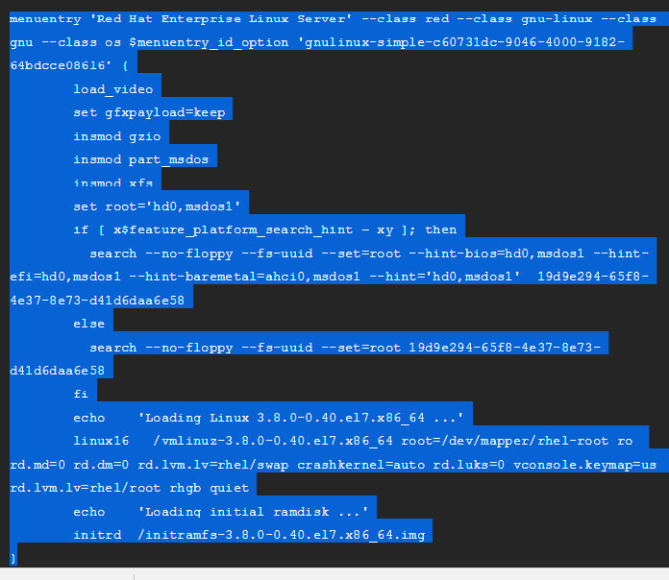
MENU ENTRIES IN GRUB.CFG

Slide 80
MENU ENTRIES IN GRUB.CFG
Each menuentry block that represents an installed Linux kernel contains linux on 64-bit IBM POWER Series, linux16 on x86_64 BIOS-based systems, and linuxefi on UEFI-based systems.
The kernel version number as given on the linux16 /vmlinuz-kernel_version line must match the version number of the initramfs image given on the initrd /initramfs-kernel_version.img line of each menuentry block

Slide 81
MAKING TEMPORARY CHANGES TO A GRUB 2 MENU
Making Temporary Changes to a Kernel Menu Entry
Start the system and, on the GRUB 2 boot screen, move the cursor to the menu entry you want to edit, and press the e key for edit.
Move the cursor down to find the kernel command line. The kernel command line starts with linux on 64-Bit IBM Power Series, linux16 on x86-64 BIOS-based systems, or linuxefi on UEFI systems.
Move the cursor to the end of the line.
Press Ctrl+a and Ctrl+e to jump to the start and end of the line, respectively. On some systems, Home and End might also work.

Slide 82
MAKING TEMPORARY CHANGES TO A GRUB 2 MENU
Edit the kernel parameters as required. For example, to run the system in emergency mode, add the emergency parameter at the end of the linux16 line:
linux16 /vmlinuz-3.10.0-0.rc4.59.el7.x86_64 root=/dev/mapper/rhel-root ro rd.md=0 rd.dm=0 rd.lvm.lv=rhel/swap crashkernel=auto rd.luks=0 vconsole.keymap=us rd.lvm.lv=rhel/root rhgb quiet emergency
The rhgb and quiet parameters can be removed in order to enable system messages.
These settings are not persistent and apply only for a single boot. To make persistent changes to a menu entry on a system, use the grubby tool.

Slide 83
MAKING PERSISTENT CHANGES TO A GRUB 2 MENU USING THE GRUBBY TOOL
The grubby tool can be used to read information from, and make persistent changes to, the grub.cfg file.
In Red Hat Enterprise Linux 7, if grubby is invoked manually without specifying a GRUB configuration file, it defaults to searching for /etc/grub2.cfg, which is a symbolic link to the grub.cfg file, whose location is architecture dependent. If that file cannot be found it will search for an architecture dependent default.
# ls -ltr /etc/grub2.cfg
lrwxrwxrwx. 1 root root 22 Apr 4 2016 /etc/grub2.cfg -> ../boot/grub2/grub.cfg

Slide 84
MAKING PERSISTENT CHANGES TO A GRUB 2 MENU USING THE GRUBBY TOOL
LISTING THE DEFAULT KERNEL
To find out the file name of the default kernel, enter a command as follows:
# grubby --default-kernel
/boot/vmlinuz-3.10.0-229.4.2.el7.x86_64
#
CHANGING THE DEFAULT BOOT ENTRY
To make a persistent change in the kernel designated as the default kernel, use the grubby command as follows:
# grubby --set-default /boot/vmlinuz-3.10.0-229.4.2.el7.x86_64

Slide 85
MAKING PERSISTENT CHANGES TO A GRUB 2 MENU USING THE GRUBBY TOOL
VIEWING THE GRUB MENU ENTRY FOR A KERNEL
L
#grubby –info=ALL
To view the GRUB menu entry for a specific kernel, enter a commands as follows:
#grubby –info /boot/vmlinuz-3.10.0-327.3.1.el7.x86_64
[root@nrpar02 grub2]# grubby --info /boot/vmlinuz-3.10.0-327.3.1.el7.x86_64
index=0
kernel=/boot/vmlinuz-3.10.0-327.3.1.el7.x86_64
args="ro crashkernel=auto rd.lvm.lv=VolGroup70/root rd.lvm.lv=VolGroup70/swap rhgb quiet LANG=en_GB.UTF-8 systemd.debug"
root=/dev/mapper/VolGroup70-root
initrd=/boot/initramfs-3.10.0-327.3.1.el7.x86_64.img
title=Red Hat Enterprise Linux Server (3.10.0-327.3.1.el7.x86_64) 7.1 (Maipo)

Slide 86
MAKING PERSISTENT CHANGES TO A GRUB 2 MENU USING THE GRUBBY TOOL
⁠ADDING AND REMOVING ARGUMENTS FROM A GRUB MENU ENTRY
#grubby --remove-args="rhgb quiet" --args=console=ttyS0,115200 --update-kernel /boot/vmlinuz-3.10.0-229.4.2.el7.x86_64
This command removes the Red Hat graphical boot argument, enables boot message to be seen, and adds a serial console. As the console arguments will be added at the end of the line, the new console will take precedence over any other consoles configured.
UPDATING ALL KERNEL MENUS WITH THE SAME ARGUMENTS
# GRUBBY --UPDATE-KERNEL=ALL --ARGS=CONSOLE=TTYS0,115200

Slide 87
MAKING PERSISTENT CHANGES TO A GRUB 2 MENU USING THE GRUBBY TOOL
CHANGING A KERNEL ARGUMENT
To change a value in an existing kernel argument, specify the argument again, changing the value as required. For example, to change the virtual console font size, use a command as follows:
#grubby --args=vconsole.font=latarcyrheb-sun32 --update-kernel /boot/vmlinuz-3.10.0-229.4.2.el7.x86_64
index=0
kernel=/boot/vmlinuz-3.10.0-229.4.2.el7.x86_64
args="ro rd.lvm.lv=rhel/root crashkernel=auto rd.lvm.lv=rhel/swap vconsole.font=latarcyrheb-sun32 vconsole.keymap=us LANG=en_US.UTF-8"
root=/dev/mapper/rhel-root
initrd=/boot/initramfs-3.10.0-229.4.2.el7.x86_64.img
title=Red Hat Enterprise Linux Server (3.10.0-229.4.2.el7.x86_64) 7.0 (Maipo)

Slide 88
LAB ON RHEL 7

